Slide 1
Algorithm Design and Analysis
Lecture 3
Amortized Analysis

Slide 2
Amortized analysis
Main goals of the lecture:
  to understand what is amortized analysis, when is it used, and how it differs from the average-case analysis;
  to be able to apply the techniques of the aggregate analysis, the accounting method, and the potential method to analyze operations on simple data structures.

Slide 3
Beyond Worst Case Analysis
Worst-case analysis.
  Analyze running time as function of worst input of a given size.
Average case analysis.
  Analyze average running time over some distribution of inputs.
  Ex: quicksort.
Amortized analysis.
  Worst-case bound on sequence of operations.
  Ex: splay trees, union-find, Fibonacci heap.
Competitive analysis.
  Make quantitative statements about online algorithms.
  Ex: paging, load balancing.

Slide 4
Sequence of operations
The problem:
  We have a data structure
  We perform a sequence of operations
    Operations may be of different types (e.g., insert, delete)
    Depending on the state of the structure the actual cost of an operation may differ (e.g., inserting into a sorted array)
  Just analyzing the worst-case time of a single operation may not say too much
  We want the average running time of an operation (but from the worst-case sequence of operations!).

Slide 5
Example for amortized analysis
Stack operations:
  PUSH(S,x), O(1)
  POP(S), O(1)
  MULTIPOP(S,k), min(s,k)
    while not STACK-EMPTY(S) and k>0
    do POP(S)
    k=k-1
Let us consider a sequence of n PUSH, POP, MULTIPOP.
  The worst case cost for MULTIPOP in the sequence is O(n), since the stack size is at most n.
  thus the cost of the sequence is O(n²). Correct, but not tight.

Slide 6
Aggregate Analysis
In fact, a sequence of n operations on an initially empty stack cost at most O(n). Why?
Each object can be POP only once (including in MULTIPOP) for each time
it is PUSHed. #POPs is at most #PUSHs, which is at most n.
Thus the average cost of an operation is O(n)/n = O(1).
Amortized cost in aggregate analysis is defined to be average cost.

Slide 7
Binary counter example
Example data structure: a binary counter
  Operation: Increment
  Implementation: An array of bits A[0..k–1]
Increment(A)
1 i ← 0
2 while i < k and A[i] = 1 do
A[i] ← 0
i ← i + 1
5 if i < k then A[i] ← 1
How many bit assignments do we have to do in the worst-case to perform Increment(A)?
  But usually we do much less bit assignments!

Slide 8
Analysis of INCREMENT(A)
Cursory analysis:
  A single execution of INCREMENT takes O(k) in the worst case (when A contains all 1s)
  So a sequence of n executions takes O(nk) in worst case (suppose initial counter is 0).
  This bound is correct, but not tight.
The tight bound is O(n) for n executions.

Slide 9
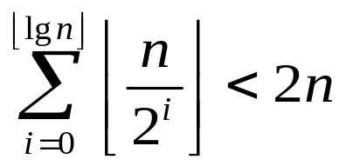
Analysis of binary counter
How many bit-assignments do we do on average?
  Let’s consider a sequence of n Increment’s
  Let’s compute the sum of bit assignments:
    A[0] assigned on each operation: n assignments
    A[1] assigned every two operations: n/2 assignments
    A[2] assigned every four ops: n/4 assignments
    A[i] assigned every 2^{i} ops: n/2^{i} assignments
Thus, a single operation takes 2n/n = 2 = O(1) time amortized time

Slide 10
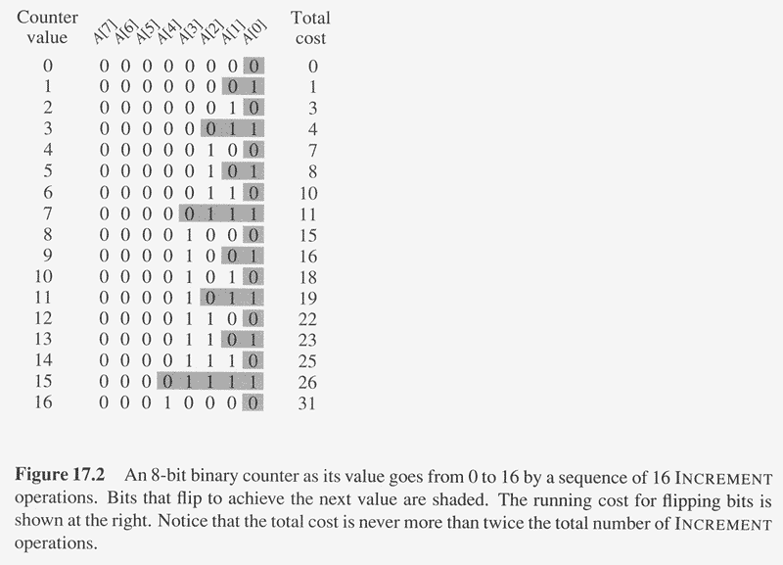
Amortized (Aggregate) Analysis of INCREMENT(A)
Observation: The running time determined by #flips
but not all bits flip each time INCREMENT is called.
A[0] flips every time, total n times.
A[1] flips every other time, ⎣n/2⎦ times.
A[2] flips every forth time, ⎣n/4⎦ times.
….
for i=0,1,…,k-1, A[i] flips ⎣n/2^{i}⎦ times.
Thus total #flips is ∑_{i=0}^{k-1} ⎣n/2^{i}⎦
< n∑_{i=0}∞ 1/2^{i}
=2n.

Slide 11
Aggregate analysis
Aggregate analysis – a simple way to do amortized analysis
  Treat all operations equally
  Compute the worst-case running time of a sequence of n operations.
  Divide by n to get an amortized running time

Slide 12
Three Methods of Amortized Analysis
Aggregate analysis:
  Total cost of n operations/n,
Accounting method:
  Assign each type of operation an (different) amortized cost
  overcharge some operations,
  store the overcharge as credit on specific objects,
  then use the credit for compensation for some later operations.
Potential method:
  Same as accounting method
  But store the credit as “potential energy” and as a whole.

Slide 13
Amortized Analysis
The Accounting Method.
We assign different charges to different operations - sometimes more than appropriate, sometimes less.
The amount we charge = amortized cost.
When charged more than the actual cost, an operation will save some credit; when charged less, it will have to draw down some of the accumulated credit.
The Stack Example.
Operation Charge
Push 2
Pop 0
Multipop 0

Slide 14
Amortized Analysis
When a Push is executed, we put 2 on the plate and take 1 to pay for the operation.
When Pop is executed, we put nothing on the plate (charge 0 to the operation) and take 1 - 0 if the stack is empty.
When Multipop is executed, we put nothing on the plate and take 1 for each Pop operation actually executed.
Total cost over n operations: O(n).
Each operation has cost O(1).

Slide 15
Amortized Analysis: Accounting Method
Idea:
  Assign differing charges to different operations.
  The amount of the charge is called amortized cost.
  amortized cost is more or less than actual cost.
  When amortized cost > actual cost, the difference is saved in specific objects as credits.
  The credits can be used by later operations whose amortized cost < actual cost.
As a comparison, in aggregate analysis, all operations have same amortized costs.

Slide 16
Accounting Method (cont.)
Conditions:
  suppose actual cost is c_{i} for the ith operation in the sequence, and amortized cost is c_{i}',
  ∑_{i=1}^{n} c_{i}' ≥ ∑_{i=1}^{n} c_{i} should hold.
    since we want to show the average cost per operation is small using amortized cost, we need the total amortized cost is an upper bound of total actual cost.
    holds for all sequences of operations.
  Total credits is ∑_{i=1}^{n} c_{i}' - ∑_{i=1}^{n} c_{i} , which should be nonnegative,
    Moreover, ∑_{i=1}^{t} c_{i}' - ∑_{i=1}^{t} c_{i} ≥0 for any t>0.

Slide 17
Another look at binary counter
Another way of looking at it (proving the amortized time):
  To assign a bit, I have to use one dollar
  When I assign “1”, I use one dollar, plus I put one dollar in my “savings account” associated with that bit.
  When I assign “0”, I can do it using a dollar from the savings account on that bit
  How much do I have to pay for the Increment(A) for this scheme to work?
    Only one assignment of “1” in the algorithm. Obviously, two dollars will always pay for the operation

Slide 18
Amortized Analysis
The Increment Example.
Operation Cost
Set a bit to 1 2
Set a bit to 0 0
When setting a bit to 1, put two units on the plate and withdraw one; when setting a bit to 0, withdraw a unit from the plate.
Cost of n operations is O(n). Cost per operation O(1).

Slide 19
Three Methods of Amortized Analysis
Aggregate analysis:
  Total cost of n operations/n,
Accounting method:
  Assign each type of operation an (different) amortized cost
  overcharge some operations,
  store the overcharge as credit on specific objects,
  then use the credit for compensation for some later operations.
Potential method:
  Same as accounting method
  But store the credit as “potential energy” and as a whole.

Slide 20

Potential method
We can have one account associated with the whole structure:
  We call it a potential
  It’s a function that maps a state of the data structure after operation i to a number: Φ(D_{i})
  The main step of this method is defining the potential function
    Requirement: Φ(D_{n}) – Φ(D₀) ≥ 0
  Once we have Φ, we can compute the amortized costs of operations

Slide 21
Binary counter example
How do we define the potential function for the binary counter?
  Potential of A: b_{i} – a number of “1”s
  What is Φ(D_{i}) – Φ(D_{i-1}), if the number of bits set to 0 in operation i is t_{i}?
  What is the amortized cost of Increment(A)?
    We showed that Φ(D_{i}) – Φ(D_{i-1}) ≤ 1 – t_{i}
    Real cost c_{i} = t_{i} + 1
    Thus,

Slide 22
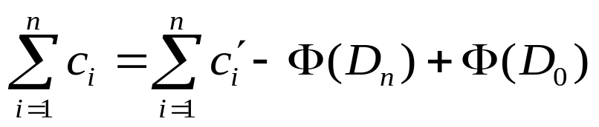
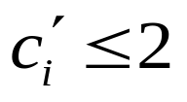
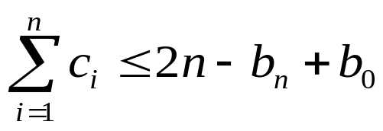
Potential method
We can analyze the counter even if it does not start at 0 using potential method:
  Let’s say we start with b₀ and end with b_{n} “1”s
  Observe that:
  We have that:
  This means that:
  Note that b₀ ≤ k. This means that, if k = O(n) then the total actual cost is O(n).

Slide 23
Dynamic table
It is often useful to have a dynamic table:
  The table that expands and contracts as necessary when new elements are added or deleted.
    Expands when insertion is done and the table is already full
    Contracts when deletion is done and there is “too much” free space
  Contracting or expanding involves relocating
    Allocate new memory space of the new size
    Copy all elements from the table into the new space
    Free the old space
  Worst-case time for insertions and deltions:
    Without relocation: O(1)
    With relocation: O(m), where m – the number of elements in the table

Slide 24
Three Methods of Amortized Analysis
Aggregate analysis:
  Total cost of n operations/n,
Accounting method:
  Assign each type of operation an (different) amortized cost
  overcharge some operations,
  store the overcharge as credit on specific objects,
  then use the credit for compensation for some later operations.
Potential method:
  Same as accounting method
  But store the credit as “potential energy” and as a whole.

Slide 25
Requirements
Load factor
  num – current number of elements in the table
  size – the total number of elements that can be stored in the allocated memory
  Load factor α = num/size
It would be nice to have these two properties:
  Amortized cost of insert and delete is constant
  The load factor is always above some constant
    That is the table is not too empty

Slide 26
Naïve insertions
Let’s look only at insertions: Why not expand the table by some constant when it overflows?
  What is the amortized cost of an insertion?
  Does it satisfy the second requirement?

Slide 27
Aggregate analysis
The “right” way to expand – double the size of the table
  Let’s do an aggregate analysis
  The cost of i-th insertion is:
    i, if i–1 is an exact power of 2
    1, otherwise
  Let’s sum up…
  The total cost of n insertions is then < 3n
  Accounting method gives the intuition:
    Pay $1 for inserting the element
    Put $1 into element’s account for reallocating it later
    Put $1 into the account of another element to pay for a later relocation of that element

Slide 28
Potential function
What potential function do we want to have?
  Φ_{i}=2num_{i} – size_{i}
  It is always non-negative
  Amortized cost of insertion:
    Insertion triggers an expansion
    Insertion does not trigger an expansion
  Both cases: 3

Slide 29
Deletions
Deletions: What if we contract whenever the table is about to get less than half full?
  Would the amortized running times of a sequence of insertions and deletions be constant?
  Problem: we want to avoid doing reallocations often without having accumulated “the money” to pay for that!

Slide 30
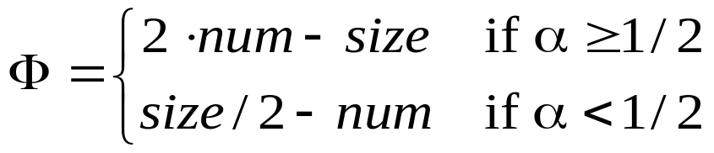
Deletions
Idea: delay contraction!
  Contract only when num = size/4
  Second requirement still satisfied: α ≥ ¼
How do we define the potential function?
It is always non-negative
Let’s compute the amortized running time of deletions:
  α < ½ (with contraction, without contraction)

